Slide 1
Creative Change Pilot Project Final Report September 2015

Slide 2
Creative Change Pilot Project - Final Report September 2015
Summary
The Creative Change Pilot Project aimed to apply creative thinking to educational challenges that were resistant to change despite the best efforts of motivated and determined educators.
The project matched educators with creative catalysts – individuals (or organisations) who offered creative approaches to thinking and problem solving. Together the creative catalyst and educator would collaborate, share ideas, explore new possibilities and generate innovative solutions to the challenges they faced.
Essentially, participants were invited to apply the four creativity skills – curiosity, open-mindedness, imagination and problem solving – to their own contexts. They were supported to explore new possibilities and empowered to change their thinking, practice and approach to continuous improvement.
The project delivered a wide range of often unexpected outcomes and impacts. The educators involved were delighted by the changes made, and the potential they saw to influence the world around them in new ways.
The Challenges
Motivated Mathematicians Anxious Learners A ‘Can Do’ School Ethos Understanding Dyscalculia
Teaching Fractions
Increasing Pupil and Parent Voice Breaking the Cycle of Parental Disengagement Bully-proofing the School Building a Sustainable Creative Hub

Slide 3
Creative Change Pilot Project - High Level Summary
Outcomes
Impact
Inputs
Activities
Outputs
10 creative catalysts
Creative Change marketplace event at The Arches
9 successful matches and distinct projects
Renewed passion for improvement and change
Improvement reported across all challenges
One to one mentoring
Showcase event at 2015 Emporium of Dangerous Ideas finale
Increased parental engagement
17 educators and establishments with challenges they were ‘stuck’ on
Improvement in challenges resistant to change
Staff CLPL and visioning sessions
Increased learner involvement
2 films documenting process and impact
Increased application of creative thinking across the education system
£17,000 budget
Project shared with a broad national audience
Co-delivered workshops with learners
Wide range of innovative outputs including: improvement plan mural, new working time arrangements, maths-jams, new three year improvement plans, creative questioning tools and approaches
Stirling Council undertake Creative Change visioning of entire service
Alternative, more positive solutions found to existing problems

Slide 4
Creative Change Pilot Project - Final Report September 2015
Rationale
Education Scotland is the national body for supporting quality and improvement in learning and teaching. Its remit includes strategic objectives to build a world-class curriculum for all learners in Scotland, promote high-quality professional learning and leadership amongst education practitioners, and to build the capacity of education providers to improve their performance continuously.
The Creativity Team within Education Scotland has a remit to deliver against Scotland’s Creative Learning Plan which, together with a strategic partnership agreement with Creative Scotland, involves sharing the vision of a more creative Scotland and developing creative learners, creative teachers and a creative education system.
The 3-18 Curriculum Impact report, Creativity Across Learning, provides a definition of creativity and identifies four core creativity skills, enabling educators and learners to recognise, articulate and value their creativity skills and offering a means of identifying good practice in all areas where we seek to model and use creativity.
The Creative Change Pilot Project was developed to put this learning into practice in the arena of improvement planning and transformational change, with the aim of embedding innovation, resilience and flexibility in the improvement process. By definition self-evaluation, the driving force behind continuous improvement, involves looking inwards and it can be difficult to know what questions you are not asking and which alternative perspectives you are not seeing the challenge from. An external catalyst coupled with highly developed curiosity and open-mindedness skills can be tools to unlock hidden potential.
‘We wanted to inject some creativity into the system and tackle existing, stubborn challenges in a new way. We’re calling this creative change.’
Creativity Team, Education Scotland
In addition, the project team aspired to manage the project management processes in a way that modelled creative change practices and embodied the four creativity skills of curiosity, open-mindedness, imagination and problem solving.

Slide 5
Creative Change Pilot Project - Final Report September 2015
Creative Change Pilot Project
Our Theory of Change
Creative solutions are generated
Increased perspectives, flexibility, adaptability, risk taking and breadth of options
Leading to Improvement
Educators and systems become progressively more creative
Creative change sets precedent, demonstrates permission, inspires further creative thinking and develops skills
Creativity skills are used to approach an existing challenge
Creative Catalysts model creative thinking and behaviours

Slide 6
Creative Change Pilot Project
The Logic Model
Priorities
Resources /
Inputs
Activities
Outputs
Outcomes
Impact
Situation
Conversation
Short Term
Medium Term
Long Term
Educators and Creative Catalysts collaborate
Practical changes and improvement
Identify educators with a challenge they are stuck on
CLPL, staff meetings, workshops
Cultural Change
More flexible systems
More creative establishments
More resilient staff
More empowered staff
Innovative and unpredicted activities
Match educators with a Creative Catalyst
Renewed passion for the challenge
New questions
New ways of looking at the challenge
Structured Approaches
Develop creative educators
More curious
More open-minded
More imaginative
Better problem solvers
Workshops with learners
Assumptions
Intended Results
We believe that everyone is creative, and equipped with a suite of creativity skills, but that these skills can be under-utilised and that obstacles exist to hinder their use.
We intend to mentor and model the use of these creativity skills in practical settings across education, and believe that this will empower educators to generate new directions and solutions to persistent problems and challenges

Slide 7
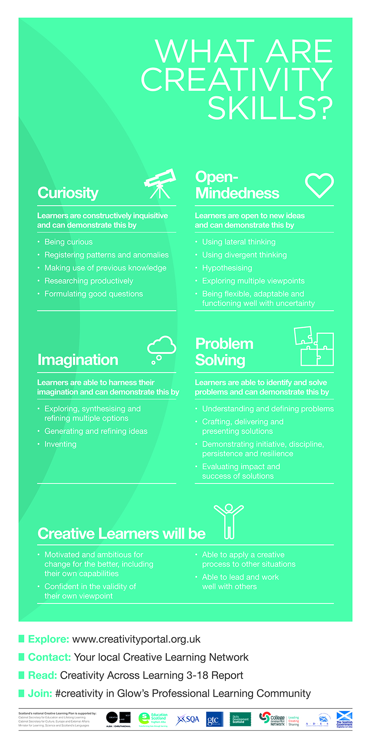
Creative Change Pilot Project - Final Report September 2015

Slide 8
Creative Change Pilot Project - Final Report September 2015
Resources and Inputs
There were three ingredients in the Creative Change Pilot Project:
Partnerships
Education Scotland’s Creativity Team worked in partnership with College Development Network and the Emporium of Dangerous Ideas to plan and deliver the project. The total project spend was £32,500.
Creative Catalysts
An open invitation was issued through a range of professional networks calling for anyone who identified themselves as being a Creative Catalyst – the creative thinkers who played the catalytic function within our theory of change. This approach gathered together a diverse range of professionals including a software developer, an architect, a national arts body, a regional arts centre, educators, producers, community artists and a graphic facilitator. We were yet to discover the extent of what this group had to offer and had to trust that our process would generate the right matches with the educators and their challenges.
Challenges
The challenges themselves were identified through a national, open invitation to Scottish educators asking them to come to us with a difficult problem they would like help in addressing.
We received nearly 20 challenges from educators including teachers, principal teachers , head teachers of nurseries, primaries and secondary schools, quality improvement teams, special units, college lecturers and heads of schools, and Community Learning and Development. The challenges presented involved a wide range of issues at all levels, including single subjects, single year groups, and whole nursery, primary or secondary establishments.

Slide 9
Creative Change Pilot Project - Final Report September 2015
Open Invitation to Educators
Is there an issue you would like to address in order to make a change that will improve outcomes for learners?
Scotland's Creative Learning Partnership is offering you a unique opportunity to help you address a challenging issue and make a transformative change. Issues and changes can be at any scale – from classroom-based to whole establishment/learning community. This invitation is open to individuals from all education sectors so there is potential for cross-sectoral partnership working.
We will help you explore your issue by matching you with a creative catalyst who will work with you, using creative approaches and coaching techniques, to help you plan and implement your change.
You are invited to register your interest with us by answering these questions:
What is the issue you would like to address?
What is the change you would like to make?
What is the impact you would like this change to have on learners?

Slide 10
Creative Change Pilot Project - Final Report September 2015
Activities - Creative Change Marketplace Event
The market place event provided an opportunity for educators to identify a suitable and inspiring creative catalyst to help them address their challenge.
Educators and catalysts were then offered the opportunity to select their top three choices, and catalysts were matched with educators by the project team to offer a best fit across all of the challenges.
The project team endeavoured to model behaviours of curiosity and open-mindedness but assumptions were challenged when rather than each educator selecting a single catalyst, several of them requested a blend of two and even three catalysts . This was especially true of those who requested the skills of the graphic facilitator, whose expertise was seen as a means of adding value to the work of another catalyst.
Two apparently diverse challenges – communicating dyscalculia, and teaching fractions to S2 learners – identified the same creative catalyst as their preferred choice. The catalyst was able to identify underlying similarities in the challenges , and saw that they could be united as a single project.
Successfully matched catalysts and educators were invited to have an initial planning meeting to identify the level of support required. They then generated a ‘bid’ for funding which was considered against all of the other ‘bids’ and a figure negotiated within the context of a limited overall budget.
Only at this point were funds agreed and a procurement process undertaken to appoint catalysts. In this way the project offered an entirely needs-based approach to funding, leaving the decisions on how to fund until as may of the unknowns were resolved as possible and guaranteeing a strong collaboration between catalysts and educators.

Slide 11
Creative Change Pilot Project - Final Report September 2015
Creative Change Marketplace
Running Order
The Arches
Introduction by Education Scotland and College Development Network
Educators shared their challenge
Catalysts shared their offer
Speed Dating style marketplace – catalysts spent four minutes each with the educators of their choice
Presentation to educators on creativity skills and continuous improvement by Education Scotland
Brief opportunity for reflection and sharing

Slide 12
Creative Change Pilot Project - Final Report September 2015
Activities - Creative Collaboration
The approach taken to address each challenge was unique, and was influenced by context, personality, skillset of both parties and timescales. The design of the project allowed for this variety and encouraged collaborative exploration.
Meetings took place between educators and catalysts and with teams within the establishments. In some cases mentoring of the educator by the catalyst formed the bulk of the project.
In many cases catalysts led formal workshops with senior management, or with the entire staff and in a few cases sessions were co-delivered for learners. Depending on the needs of the challenge, the influence of the catalyst was targeted at changing thinking across the staff or holistically, across the whole school community.
In two projects the catalyst delivered professional learning before co-delivering a series of workshops for learners with the educators involved, empowering the m with practical teaching skills and approaches as well as developing their creativity skills. The graphic facilitator demonstrated and ran professional learning for staff in documenting and evidencing meetings visually. In some cases, learners also experienced this training.
In one challenge the creative catalyst took community walks or ‘wanders’ to explore the locality and make connections with local people . This approach has developed out of the Emporium of Dangerous Ideas.
Other catalysts used their experience and networks to provide additional resources to the educators in order to make powerful connections and generate sustainable relationships. For example the DCA linked the school to scientists and artists, whilst Susan Hay advertised and recruited local artists for the school’s Creative Hub.

Slide 13
Creative Change Pilot Project - Final Report September 2015
Outputs
The project offered solutions to nine diverse challenges, each of which generated their own unique outputs. These included the following:
Maths-Jam events for staff - bringing other specialisms together with maths to contextualise and make it relevant.
New 3 year improvement plans
An outdoor mural of an improvement plan
Revised working time arrangements (through consultation with the Unions)
New creative questioning tools for use with learners and staff
Co-delivered workshops for learners with staff
A community website
Films created by learners
Revised and new course materials at Broad General Education level
New learning pathways
Co-designed experiential learning days
Physical resources to stimulate creative thinking in learners
The graphic facilitator generated large scale visuals for several projects creating not only a lasting resource of their journey but also a means of demonstrating and evidencing the thinking behind their creative solutions.
An award winning filmmaker was commissioned to document the process and impact of the project overall. He was selected for both his highly skilled, creative approach and for his wealth of experience of working in educational settings. This enabled him to gauge the appropriateness of filming in any given setting, and to be sensitive to the needs of the staff and everyday running of the school, prioritising that above ‘getting the job done’. The filmmaker provided a full 18 minute documentary of the project and a 4 minute overview which was well received at the Emporium of Dangerous Ideas Finale.

Slide 14
Creative Change Pilot Project - Final Report September 2015
Outcomes
Short term differed greatly across the challenges. Often these were not the original outcomes identified. Initial conversations often identified that the challenge was either symptomatic of an underlying issue, or was so interconnected with other challenges that the work shifted focus. For example, one school had identified bullying as the key issue they wanted to address, but creative thinking helped them recognise that a lack of cohesion within the school was the chief underlying cause. Flexibility and changes in direction were supported and encouraged as an indicator that educators and catalysts were demonstrating curiosity and open-mindedness in the work. Outcomes shared by most, if not all projects included the following:
Increased aspiration for change and improvement by educators and the wider staff
More creative staff embracing and generating creative ideas and solutions more readily
Crucially staff report seeing themselves as more creative than before the project
Sustained relationships between educators and catalysts
Shared understanding and belief in a central vision, often for the first time
Increased leadership capacity
The following outcomes were also reported by one or more educators:
Staff meetings are being held outside of the school in at least one establishment to encourage creativity (an approach backed up by research)
Staff report having a transformed attitude towards their own subject
Equality of staff engagement across a whole establishment
Increased belief in inter-disciplinary learning
Increased trust by staff in the leadership and in each other
Increased pride in achievements by staff
One school won the 2015 Scottish Education Awards - Creative Learning Category

Slide 15
Creative Change Pilot Project - Final Report September 2015
Across all of the projects educators and their staff reported gaining new skills. In some cases, these relate directly to CLPL with the graphic facilitator and in others, to the unusual approaches demonstrated and shared by other catalysts:
Increased creativity skills
Increased willingness to challenge the status quo (open-mindedness and imagination)
Increased problem solving skills
Improved listening skills (staff and learners)
New transferable skills in planning and sharing
Increased empathy
Beyond the intended reach of the project there have been sizeable outcomes that are worth mentioning here.
As a direct result of their work on this project, three of the catalysts were able to demonstrate their potential to Stirling Council’s senior management team and have been contracted to consult on a re-visioning of Education Services. They have planned engagement with learners, parents, educators and management and are using the Creative Change Pilot Project model of working.
The creative catalysts have formed a new community which meets regularly, sharing practice and learning, and working in collaboration on a range of other projects.
One creative catalyst has opted to work full time in this area of work, leaving her part-time day job, demonstrating a new awareness of the impact of this type of work

Slide 16
Creative Change Pilot Project - Final Report September 2015
Impact
The Creative Change Pilot Project sought to work with educators to develop their thinking. Whilst many of the projects led the catalysts and educators into practical activity, direct delivery of professional learning, and co-delivery of workshops for learners with staff, our intention was to focus on how the project impacted on the skills, behaviours and thinking of the educators involved. We chose to follow a contribution analysis process for planning and evaluating the project in order to capture this initial impact. Our theory of change fully supports the belief that this small input will have long term impact in the establishments involved and that the project will be a catalyst for immediate and continuous improvement.
Educators reported, unanimously, that they believed the project would have long term impact on learners, staff and establishments, and that the following impacts were likely as a direct result of the project:
Increased creativity skills for educators and staff
Increased passion for improvement across the whole establishment
Increased ability to generate and deliver creative solutions
Increased teacher capacity
Increased learner capacity
Increased empowerment of staff
Educators reported additional long term impacts relating to specific projects including:
Increased engagement with parents and the local community
A sustainable creative learning environment
Increased attainment
Increased uptake of Higher Maths
Lifelong Learning is nurtured in the establishment

Slide 17
There are several characteristics of the project that demand a level of anonymity in reporting. The honesty with which educators presented challenges they were having difficulty solving should be celebrated. This took the courage and openness of effective leadership. What were sometimes difficult and sensitive challenges were presented with passion, revealing a high level of professional commitment to the wellbeing of the learners. Catalysts encouraged educators to think holistically, engage their creativity skills, and explore all areas of their context and work, which often led to intense and sometimes emotionally charged conversations. Finally, the activities and outcomes of the project often raised issues involving other staff, their expertise and working relationships. Some examples of the kind of impact the project had on individuals are presented here, illustrating the emotional, yet empowering journey they went on as part of the continuous improvement of the school.
There were tears. There was a moment when the educator, challenged and reflecting objectively, had the realisation that not everyone is capable of compassion, and that included their own staff.
But there were also moments when staff realised the potential of what they were doing, when tears of joy happened too.
There were mixed moments when staff cried because they felt listened to for the first time in a long, long time.
Staff were incredibly open in their reflection as a result of the way we supported the process.
On more than one occasion staff noted that they had ‘not been listened to before’.
On more than one occasion staff reported serious divisions amongst themselves that actively blocked improvement and change.
Creative Catalysts

Slide 18
Creative Change Pilot Project - Final Report September 2015
Next Steps
The positive feedback from educators involved, and the sustained relationships they have forged with creative catalysts provide strong evidence of the effectiveness of the project, and an indication that other educators with new challenges would benefit from a similar approach.
In many cases educators report feeling empowered to take their new skills , attitudes and approaches forwards without further support. This reflects well on the needs-based offer the project model supported, which was more likely to fulfil the needs of the educators than a ‘one size fits all’ approach. Whilst there is a strong demand for continued input from educators and catalysts involved in some of the challenges, on-going support is not built into the project, and participants are being encouraged and assisted to pursue other funds and means of support.
Education Scotland hosted an evaluative session with the creative catalysts in order to reflect on the learning and discuss next steps. The idea of a project which set out to focus on specific challenges, such as attainment, senior phase or equity, was discussed, but it was felt that this would distract from the core tenets of the project and that these challenges may be revealed through the process anyway. It was agreed that educators should be invited to bring whichever challenges they felt were important and that those challenges were likely to relate to national priorities.
Other topics discussed included the scale of challenges funded, and the idea of inviting senior management or even local authority level challenges. The consensus was, however, that the variety of challenges tackled by the Pilot Project was one of its strengths. Working across all levels and across several sectors allowed us to model a creative approach to improvement and share it with as broad an audience as possible. This reach could be expanded to include special schools, colleges and community learning groups.

Slide 19
Creative Change Pilot Project - Final Report September 2015
Next Steps - practicalities
Procurement rules mean that prolonged contract working with any one individual or company is restricted, and therefore there is a need to identify and perhaps coach new creative catalysts in order to meet demand. Alternative approaches and creative solutions are also being considered, such as issuing grants directly to schools so that they can appoint creative catalysts; arguing the ‘special case’ for contracting catalysts through the existing procurement system; or catalysts offering their services through umbrella organisations.
Future projects would benefit from the involvement of the Creative Learning Networks who would bring new catalysts, partnerships and sharing opportunities to the work, increasing impact.
Engaging with the Creative Change Pilot Project took bravery and risk-taking on the part of the educators involved. It is important that any sharing of learning from the Pilot Project, and the processes involved in any future projects, protects them in order to encourage more openness across the education system in general.
In delivering an project that models the creativity skills and remains as flexible and adaptable as possible the project team faced their own challenges, working within the existing systems such as procurement frameworks, project planning and milestones. The need for effective problem solving and open-mindedness would remain a constant in any future work.

Slide 20
The Individual Challenges Motivated Mathematicians Forfar Academy and Dundee Contemporary Arts Anxious Learners Boclair Academy and Patrick Boxall, Create and Connect Learning/Clare Mills, Graphic Facilitator A ‘Can Do’ School Ethos Kings Park Secondary and Scott Sherwood, Live Think Design/Clare Mills, Graphic Facilitator Understanding Dyscalculia/Teaching Fractions East Dunbartonshire Education Support Team/Oxgang Primary and NYCOS Increasing Pupil and Parent Voice Knightswood Secondary School and Scott Sherwood/Clare Mills, Graphic Facilitator Breaking the Cycle of Parental Disengagement Wyndford Nursery and Paul Gorman, Hidden Giants Bully-proofing the School Westerton Primary and Scott Sherwood, Live Think Design/Clare Mills, Graphic Facilitator Building a Sustainable Creative Hub Dalry Primary School and Susan Hay, Ripple Arts/Clare Mills, Graphic Facilitator

Slide 21
Creative Change Pilot Project
The Logic Model
Priorities
Resources /
Inputs
Activities
Outputs
Outcomes
Impact
Situation
Conversations
Short Term
Medium Term
Long Term
Educators express interest and identify a challenge they are stuck on
Renewed passion for the challenge
New questions
New ways of looking at the challenge
CLPL, staff meetings, workshops
Practical changes and improvement
Match educators with a creative catalyst
Educators and creative catalysts collaborate
Innovative and unpredicted activities
Structured approaches
Creative educators:
More curious
More open-minded
More imaginative
Better problem-solvers
Cultural Change
More flexible systems
More creative establishments
More resilient staff
More empowered staff
Inputs with learners
Assumptions
Intended Results
We believe that everyone is creative, equipped with a suite of creativity skills, but that these skills can be under-utilised and that obstacles exist to hinder their use
We intend to mentor and model the use of these creativity skills in practical settings across education, and believe that this will empower educators to generate new directions and solutions to persistent problems and challenges

Slide 22
Creative Change - Motivated Mathematicians
Forfar Academy and Dundee Contemporary Arts
Priorities
Resources /
Inputs
Activities
Outputs
Outcomes
Impact
Situation
Conversations
Short Term
Medium Term
Long Term
Identify educators with a challenge they are stuck on
Staff meetings are being delivered outside the school to encourage creativity and respect
Increased attainment
Renewed passion for the challenge
New questions
New ways of looking at the challenge
CPD, staff meetings, workshops
Practical changes and improvement
Maths Jam Events
Creative conversations between staff and
visual artists
architects
botanists
musicians
This year’s S2 pupils ‘choosing’ to take Maths Higher because of their interest in the subject, not only for career choice
Match educators with a creative catalyst
Educators and Creative Catalysts collaborate
Innovative and unpredicted activities
Revised, transformed and new course materials
Staff report transformed attitudes towards the subject
Structured approaches
Develop creative educators
More curious
More open-minded
More imaginative
Better problem-solvers
Cultural Change
More flexible systems
More creative establishments
More resilient staff
More empowered staff
We would like to change the learner mindset “I go because it’s important and I have to” to “I want to go”. Whilst appreciating that we will never win over all the pupils we would like the pupils to not only see the relevance but also the intrinsic beauty of Mathematics.
Increased uptake of Higher Maths
All staff now see themselves as creative
Inputs with Learners
!
There were no obstacles identified by those involved.
Challenged Assumptions
Next Steps
The project succeeded in breaking down the assumption held by staff that mathematicians are not creative.
Staff are eager to trial new ideas and creative thinking with learners – outputs include new course materials and broader IDL opportunities.

Slide 23
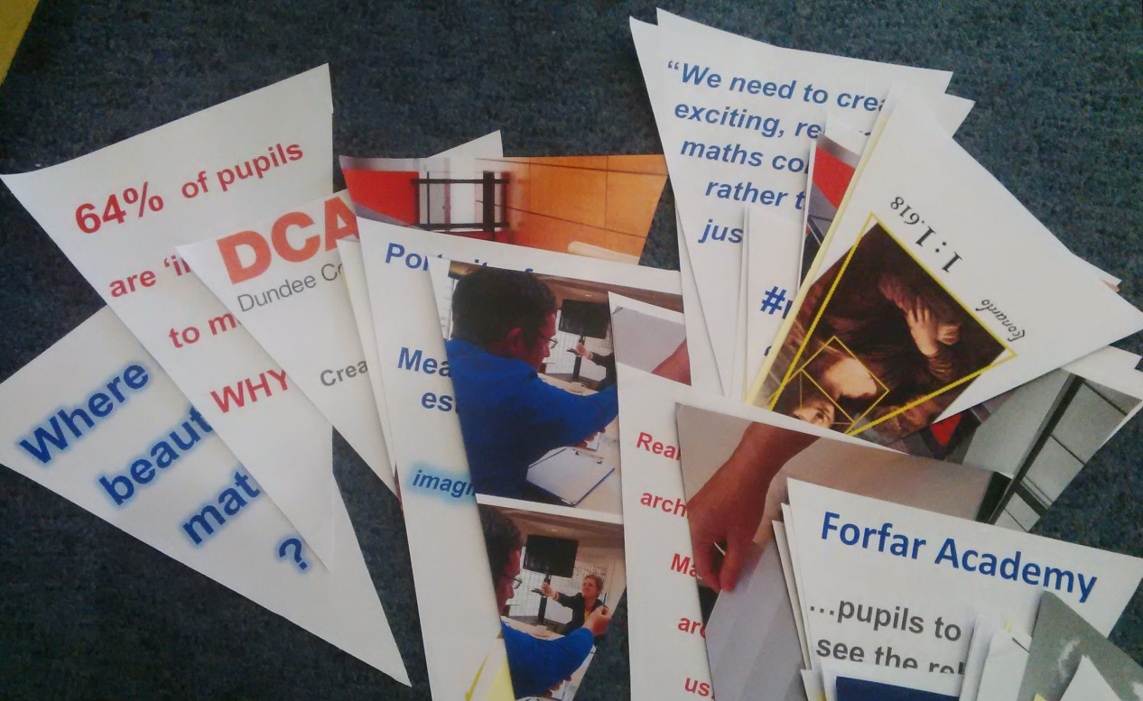
“It’s been great. It has been fantastic. We have had some wonderful things happen. It has grown and grown. We just feel guilty that we haven’t shared it with the learners yet.”
Educator
“We have always been quite creative, but this has changed our attitudes. We are adding new things to the curriculum, big things, but it is the little changes of how we perceive maths that is going to make the real difference.”
“We asked ‘why can maths not be creative?’ and this was a struggle, but we all managed it. We all found this out in various ways.”
Educators

Slide 24
Creative Change – Anxious Learners
Boclair Academy and Patrick Boxall, Create and Connect Learning/Clare Mills, Graphic Facilitator
Priorities
Resources /
Inputs
Activities
Outputs
Outcomes
Impact
Situation
Graphic recording and planning – visual and person centred
Conversations
Clear learning paths
Short Term
Medium Term
Long Term
Identify educators with a challenge they are stuck on
Better listening
Renewed passion for the challenge
New questions
New ways of looking at the challenge
Increased confidence in IDL
CPD, staff meetings, workshops
Practical changes and improvement
Staff events on
strategic objectives
team building
IDL
team facilitation
New links to learning from non-traditional sources
Two diverse creative catalysts connected – an educator and a graphic facilitator
New transferable skills in planning and sharing
Improved learner capacity
Match educators with a Creative Catalyst
Educators and Creative Catalysts collaborate
Innovative and unpredicted activities
‘The Zombie Virus’ experiential learning day
Increased problem solving ability
Structured approaches
Develop creative educators
More curious
More open-minded
More imaginative
Better problem-solvers
Cultural Change
More flexible systems
More creative establishments
More resilient staff
More empowered staff
Reconnect with new staff and revised priorities
Pupils as young as S1 are developing anxiety in relation to their studies and life in the school. We would like to create an environment where we can use the skills and strengths of our teachers to support, nurture and educate these pupils to become strong, confident and resilient young people who
are equipped to face the challenges within school and beyond.
Improved leadership capacity
Improved teacher capacity
Inputs with Learners
Equality of engagement across staff
Shared understanding of the vision
!
Staff changes and specifically changes in remits and teams meant re-connecting became difficult
Challenged Assumptions
Next Steps
The project challenged the assumption that anxiety in learners was difficult to tackle by individual teachers and lessons.
Staff will roll out their learning across all subjects and share with colleagues.

Slide 25
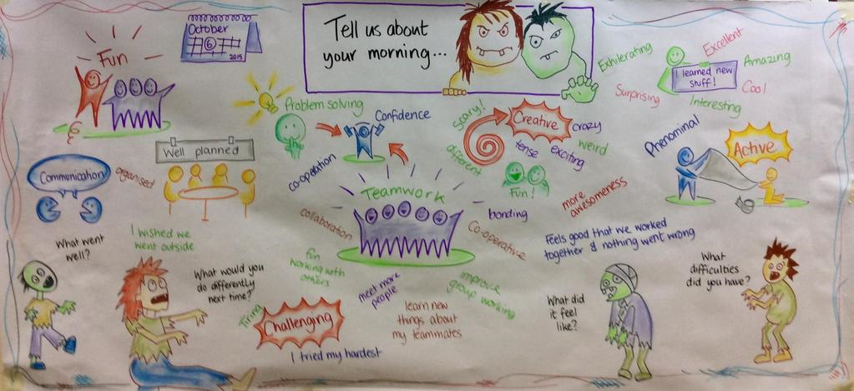
“Teachers and schools are busy and have a lot of core business to get through. Just to organise to bring in capacity takes capacity. This was stretched initially, but as soon as the leadership got a clearer vision of the project then the balance shifted and it become clear that we could help solve problems.”
Creative Catalyst
“The micro politics of staffing/school culture were blockers, but with discussion the project can now support solutions to these issues. It is now a point of focus for collegiate working and shared performance rather than noise off stage-left…”
Creative Catalyst

Slide 26
Creative Change – A ‘Can Do’ School Ethos
Kings Park Secondary and Scott Sherwood, Live Think Design/Clare Mills, Graphic Facilitator
Priorities
Resources /
Inputs
Activities
Outputs
Outcomes
Impact
Situation
Creative writing lessons
Conversations
Short Term
Long Term
Training on graphic facilitation and map process (staff and learners)
Alignment of vision between learners and staff
Medium Term
Identify educators with a challenge they are stuck on
New toolkits and activities designed to lead improvement and collaboration
Renewed passion for the challenge
New questions
New ways of looking at the challenge
Sustainable and increased empowerment of staff
CPD, staff meetings, workshops
Practical changes and improvement
Greater impact in all areas of school business
6 month commitment to change by all staff
Match educators with a Creative Catalyst
Educators and Creative Catalysts collaborate
Innovative and unpredicted activities
Increased listening, confidence, sharing and pride in achievements amongst staff
Creative Conversation tool storytelling sessions
Increased trust across the establishment
Large scale mapped visuals of the discussions and shared visions
Develop creative educators
More curious
More open-minded
More imaginative
Better problem-solvers
Cultural Change
More flexible systems
More creative establishments
More resilient staff
More empowered staff
We would like to enhance the ethos within the school to be one where pupils, staff and parents have high aspirations and where they develop their resilience to change/developments in a more positive manner. This requires pupils, staff and parents to be more solution-focused in their approaches to
change and also to develop a positive thinking “can do” environment
within the school.
Structured approaches
Increased capacity for continuous improvement across all areas of the school
9 meetings involving groups of staff and learners
Willingness to challenge the status quo
Inputs with Learners
PDR away day co-delivered with SMT
Mini improvement plans
Staff show initiative and lead change
Challenged Assumptions
Next Steps
The project challenged the assumption that improvement was the domain of the senior management team, and that improvement could be achieved without the learners’ full participation.
The toolkits developed by the project are to be used across the curriculum with educators and learners to expand the potential for improvement.

Slide 27
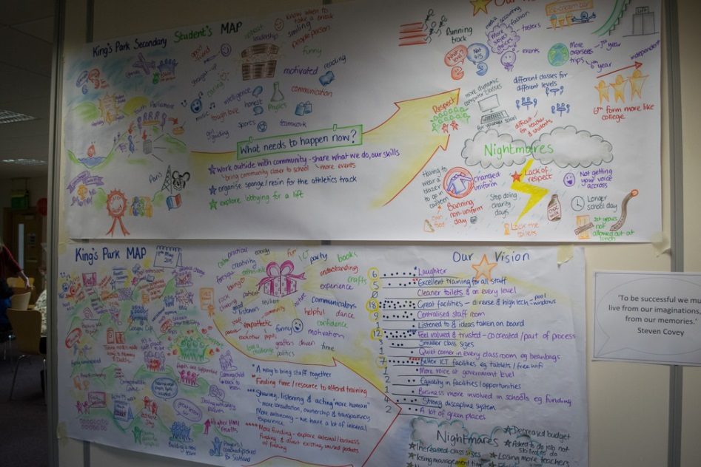
“One teacher used the Creative Conversation tool for creative writing without any prompting from the catalysts. I believe this shows the desire to be creative in us all, however we can’t start with a blank canvas we must have parameters or we get paralysed by choice.”
Creative Catalyst
“We used graphic facilitation to develop maps of the teachers’ proudest moments, gifts and skills, aspirational visions and nightmare visions. These were condensed into a mini-plan for improvement.”
Creative Catalyst

Slide 28
Creative Change – Understanding Dyscalculia/Teaching Fractions
East Dunbartonshire Education Support Team/Oxgang Primary and NYCOS
Priorities
Resources /
Inputs
Activities
Outputs
Outcomes
Impact
Situation
Identify educators with a challenge they are stuck on
Conversations
Short Term
Medium Term
Long Term
Co-delivered music, rhythm and maths workshops with learners in both areas
Renewed passion for the challenge
New questions
New ways of looking at the challenge
CPD, staff meetings, workshops
New music and maths related teaching skills developed
Practical changes and improvement
Match educators to each other
The change I would like to make is for teachers, initially,...... developing the recognition/understanding of the impact this disability can have on a learner. I would like learners to have the right support to challenge this particular barrier to learning.
Creative catalysts identified cross-over between two diverse challenges
Increased understanding of inter-disciplinary learning
Match educators with a Creative Catalyst
Educators and Creative Catalysts collaborate
Innovative and unpredicted activities
Professional learning delivered
Continued partnership working with NYCOS
Increased attainment – specifically in numeracy
Structured approaches
Develop creative educators
More curious
More open-minded
More imaginative
Better problem-solvers
Cultural Change
More flexible systems
More creative establishments
More resilient staff
More empowered staff
School choir established and funded
Inputs with Learners
Increased learner engagement in numeracy and maths
As an art school graduate I like to think that I usually approach teaching & learning in an innovative way, but Numeracy & Mathematics is an area that I struggle to plan creatively in.
Challenged Assumptions
Next Steps
The project team assumed that such diverse challenges would require different approaches – no one saw the synchronicity except for the Creative Catalyst.
To develop a school choir which answers both the maths and music focuses of the school improvement plan. To ensure the sustainability of the skills developed in staff through sharing.

Slide 29
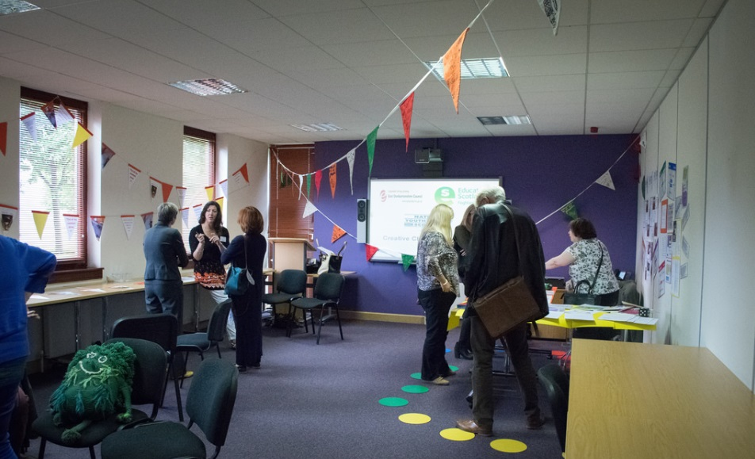
“The more she spoke about it the more I thought OK, this lady [the catalyst] has something to offer here. You know, you could never make… well, I could never make that link and I think that’s the problem.”
Educator
“I’m always searching for new approaches, probably always very academic approaches. But this is a creative approach and that is a huge, huge challenge for me… because it’s not normally something that I’m comfortable with.”
Educator

Slide 30
Creative Change – Increasing Pupil and Parent Voice
Knightswood Secondary School and Scott Sherwood/Clare Mills, Graphic Facilitator
Priorities
Resources /
Inputs
Activities
Outputs
Outcomes
Impact
Situation
Initial challenge revised – aspiration is revealed as being the crux of the challenge
Conversations
Short Term
Medium Term
Long Term
Actions to support aspirations - identified by learners
Identify educators with a challenge they are stuck on
Renewed passion for the challenge
New questions
New ways of looking at the challenge
Increased and sustainable staff empowerment
Initial challenge refined through conversation and reflection
Increased engagement of staff in all areas of the school experience
Practical changes and improvement
CPD, staff meetings, workshops
Match educators with a Creative Catalyst
Educators and Creative Catalysts collaborate
Innovative and unpredicted activities
Teachers – train the trainer activity
Actions to support teachers – identified and undertaken by learners
Increased drive for continuous improvement
Increased attainment through continued engagement
Develop creative educators
More curious
More open-minded
More imaginative
Better problem-solvers
Cultural Change
More flexible systems
More creative establishments
More resilient staff
More empowered staff
We believe that we have made a significant start in addressing universal Health and Wellbeing but that many aspects of this are fragmented. There are issues with consistency of delivery but we do not wish to implement simplistic quality assurance processes that undermine the innovation and creativity
that could make this a truly meaningful transformative programme
for pupils and for staff
Structured approaches
Increased learner engagement
Physical spaces interrogated – observations of learners and educators
Learners – train the trainer activity
Increased capacity for continuous improvement across all areas of the school
4 Rs – language re-claimed by staff
Aspire workshops x5
Inputs with Learners
4 Rs workshop
Creative Conversation Tool storytelling sessions
Challenged Assumptions
Next Steps
The project challenged the assumption that a single catalyst would cover the needs of the challenge.
The long term impact of the project on the delivery of teacher aspirations and pupil engagement needs to be monitored and reported on.

Slide 31
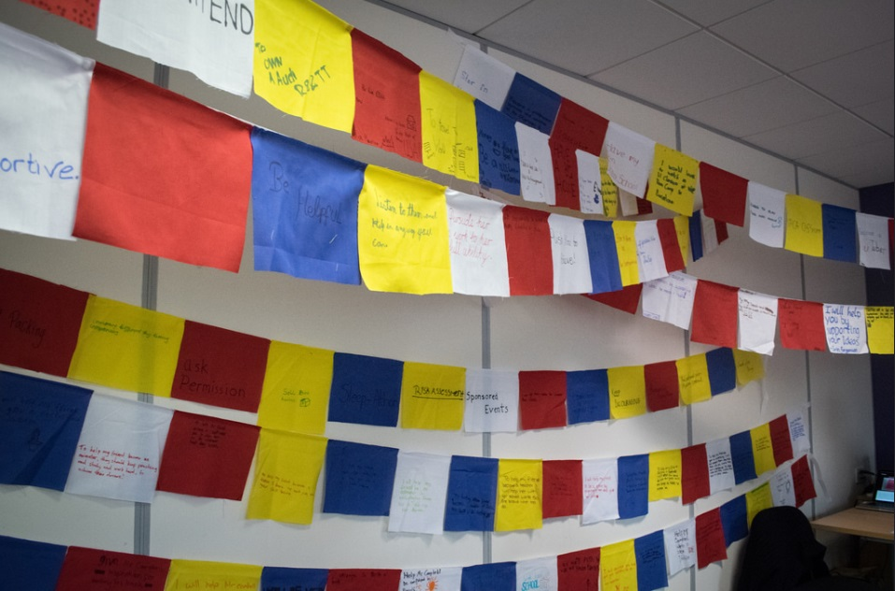
I Creative Catalyst
“You do need to make yourself vulnerable and be prepared to swap roles. [A] very bonding experience for a tutor class. I think the class gets more out of it if you tell your true dreams!!! So worth the risk…”
Educator
“V powerful. Excellent participation. [Pupils are] lovin it! They are helping me with my own creative change!!!!”
Educator

Slide 32
Creative Change – Breaking the Cycle of Parental Disengagement
Wyndford Nursery and Paul Gorman, Hidden Giants
Priorities
Resources /
Inputs
Activities
Outputs
Outcomes
Impact
Situation
Revised additional priorities – need to look at staff development, curriculum design and environment
Catalyst met the community on the streets
Whole school/community literacy project to dispel myths around learning
Conversations
Whole school approach adopted by staff
Long Term
Short Term
Medium Term
Identify educators with a challenge they are stuck on
Parents take an active role in child’s learning throughout their school life
Renewed passion for the challenge
New questions
New ways of looking at the challenge
CPD, staff meetings, workshops
Parents adopting responsibility for engaging children in learning
Practical changes and improvement
Regular open and creative conversations with the Head Teacher
Physical creative stimuli in the form of plants and books
Match educators with a creative catalyst
Educators and Creative Catalysts collaborate
Innovative and unpredicted activities
Staff actively engaged in all aspects of planning and learner engagement
New focus on community engagement
Lifelong learning nurtured
Intensive engagement with 3 staff exploring creative ways to share school values
3 year school improvement plan
Structured approaches
Develop creative educators
More curious
More open-minded
More imaginative
Better problem-solvers
Cultural Change
More flexible systems
More creative establishments
More resilient staff
More empowered staff
We are excited to look differently at how we might ‘market ourselves’ to our families in a manner which changes the lens through which they view our service- recognising that family learning can be fun but will take some action on their part, in order to break the cycle of what they know does not
feel good for them- and realise change for their children’s future.
New focus on induction of new families
Wyndford community is a healthy, creative thinking community
Establishing action research experiments, that progress school vision
Inputs with Learners
!
Confusion over Disclosure
blocked inputs
More Catalyst time required
Sustained relationship with creative catalyst
Challenged Assumptions
Next Steps
That parental engagement could be solved by ‘offering’ options to parents as one-offs.
Build on the three year plan. Identify and apply for funding to sustain the work that is needed.

Slide 33
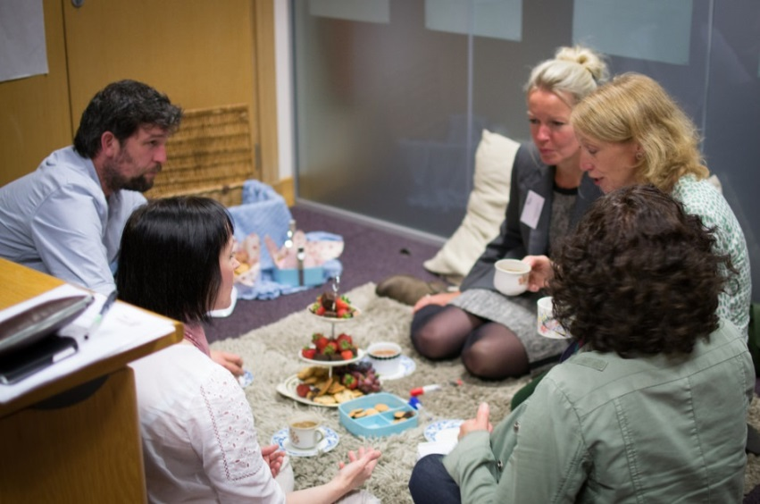
“Solving a ‘wicked’ task, such as parental engagement, is really difficult. You are faced with engrained generational, cultural and societal issues. It is easy to shy away from them or create a system which is functional but not aspirational.”
Creative Catalyst
I believe my creative intervention allowed Mary Pat to have an external pair of eyes to observe what was happening and ask questions of how it could be done differently. It wasn’t about being in charge of an activity or leading from the front – it was about listening, observing and questioning. There was no art produce or obvious example of children engaged in creative activity. The intervention was my creative gaze which didn’t offer anything new but confirmed what was already there and formed new collaborations to work through the discoveries.
Creative Catalyst
Trees need leaves like girls and boys need toys. This is a story of a lonely tree that lost its leaves and a tale of how a nursery helped it find its roots.
The Lonely Tree
storytelling resource

Slide 34
Creative Change – Bully-proofing the School
Westerton Primary and Scott Sherwood, Live Think Design/Clare Mills, Graphic Facilitator
Priorities
Resources /
Inputs
Activities
Outputs
Outcomes
Impact
Situation
Initial challenge revised – bully-proofing was the manifestation of lack of cohesion across the school
Conversations
Short Term
Medium Term
Long Term
1 to 1 coaching
Increased leadership capacity in Head Teacher
Identify educators with a challenge they are stuck on
Priorities diamond
Renewed passion for the challenge
New questions
New ways of looking at the challenge
CPD, staff meetings, workshops
Increased empathy across the staff
Practical changes and improvement
Whole staff community Creative Conversation Tool storytelling sessions with teachers, dinner ladies, admin staff
Sustainable and increased empowerment of staff
Match educators with a Creative Catalyst
Educators and Creative Catalysts collaborate
New model for the staff’s working time agreement
Innovative and unpredicted activities
Improved nurturing environment for learners and staff
For children – We would like to work on ‘bully-proofing’ our school in a focused and motivating way. At assemblies we have discussed being a ‘communicating’ school and we would like to work with others in bringing this to life in a way which is truly meaningful for our learners. Staff – Successful
implementation of our work would be reliant on changes in culture
and practice. Our staff will need guidance and support to facilitate
them in working together to help address this challenge.
Develop creative educators
More curious
More open-minded
More imaginative
Better problem-solvers
Cultural Change
More flexible systems
More creative establishments
More resilient staff
More empowered staff
Group exploration session on visions and values
Structured approaches
Improved learner journeys through school life
Meetings between trade unions and teachers
Increased understanding of diverse staff needs
Increased engagement by staff
Sustainable improved and cohesive learner experience
Inputs with Learners
!
Available dates of the school and those remaining with the catalysts failed to match within the original timescale of the project.
Challenged Assumptions
Next Steps
The project challenged the assumption that a single catalyst would cover the needs of the challenge and that bullying was a stand-alone issue that could be tackled in isolation.
The long term impact of the project on the delivery of teacher aspirations and pupil engagement needs to be monitored and reported on.

Slide 35
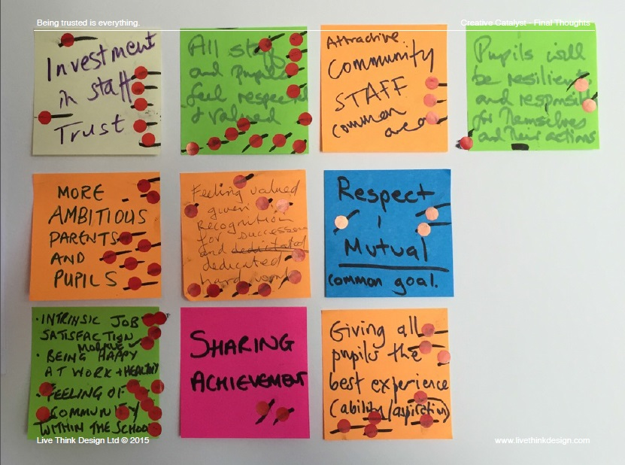
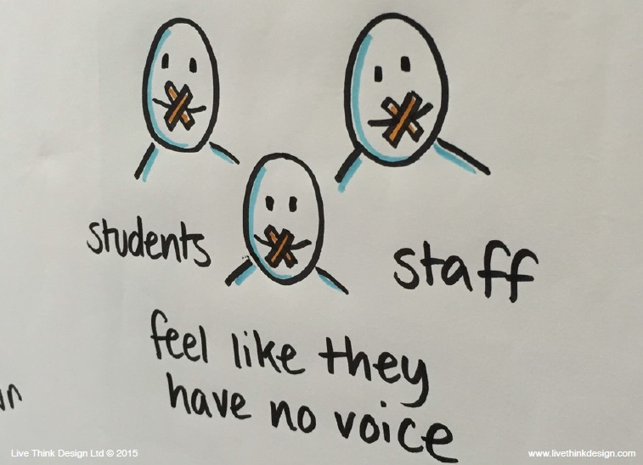
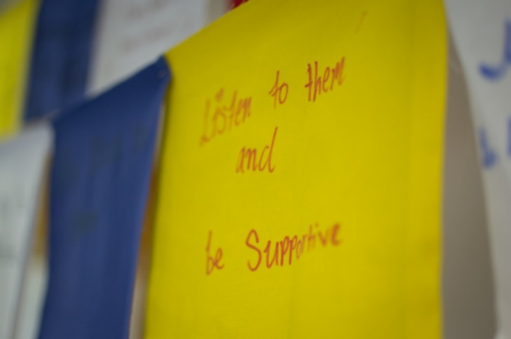
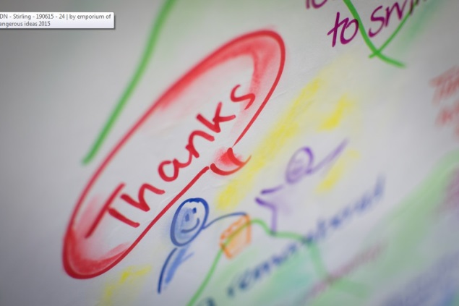

Slide 36
Creative Change – A Sustainable Creative Hub
Dalry Primary School and Susan Hay, Ripple Arts/Clare Mills, Graphic Facilitator
Priorities
Resources /
Inputs
Activities
Outputs
Outcomes
Impact
Situation
Community web page for artists
Sustained partnerships with local artists
Conversations
Short Term
Medium Term
Long Term
Winner of the SEAS Creative Learning Award – increased confidence and pride
Increased engagement with parents and community
Identify educators with a challenge they are stuck on
New partnerships with 8+ local artists
Renewed passion for the challenge
New questions
New ways of looking at the challenge
CPD, staff meetings, workshops
Practical changes and improvement
Increased aspiration – plans to turn school into a Fringe venue
Sustained creative learning environment
Two diverse creative catalysts connected – a producer and a graphic facilitator
Visioning workshop for all staff
School improvement plan painted as a mural on the outside wall of the school
Match educators with a Creative Catalyst
Educators and Creative Catalysts collaborate
Innovative and unpredicted activities
More creative staff – pursuing an indoor beach and treetop school for learners
Cultural Change
More flexible systems
More creative establishments
More resilient staff
More empowered staff
Off-curriculum Creative Week
Structured approaches
Develop creative educators
More curious
More open-minded
More imaginative
Better problem-solvers
I want to make sure that all pupils and parents are involved in the planning of projects and our school is seen as a creative resource with a two way flow. All of our projects have been very successful but I want to standardise the planning format without sapping spontaneity and seized opportunity. I want to make it last and each project should link, leaving an echo.
Renewed passion for improvement across the whole school
School improvement planning visualised
Inputs with Learners
!
2 hour workshops were curtailed to <1 hour
1 artist struggled to engage learners
Sustained relationship with creative catalyst
Vimeo film by pupils
Challenged Assumptions
Next Steps
The project challenged the assumption that educators would connect with a single catalyst – their vision went beyond this; also that improvement planning was an internal affair.
The school and catalyst are actively seeking funding to bring the school alive as a Festival Fringe venue that compliments the learning and builds resources.

Slide 37
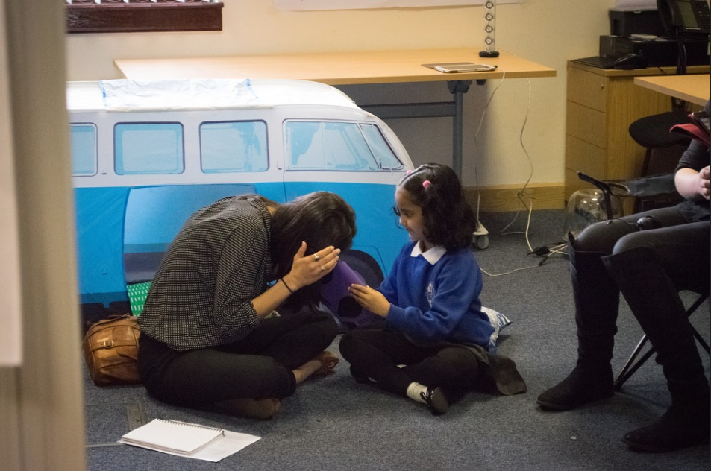
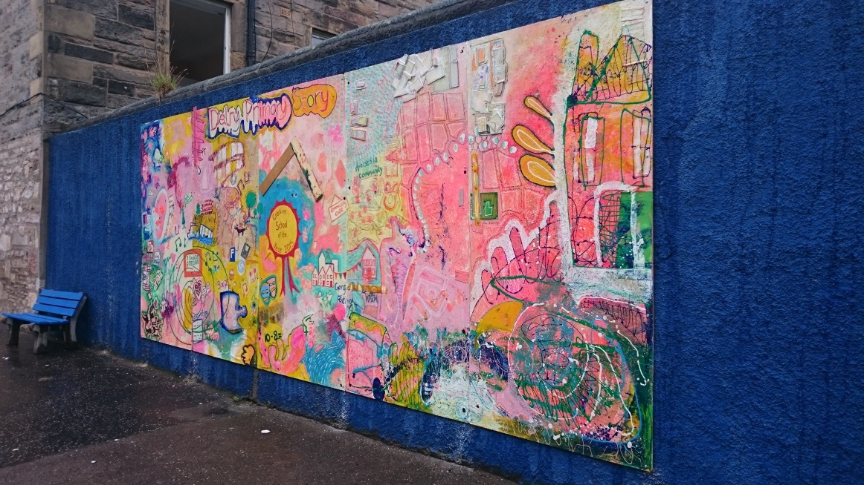
“[The Head Teacher] has a very clear vision about where he wants the school to go and is very creative in his approach. Working with him is like working with an artist - capturing ideas, being realistic about how to make it happen, working with the staff to get them inspired and trying to make projects happen practically - setting up templates, check lists and funding application outlines.”
Creative Catalyst
We now have ideas of trying to turn the school into a Fringe space, creating a tree house internally, a beach and other messy areas that can be used by performers and left for the children to explore and play with.
Educator
https://vimeo.com/123181899
http://www.ripplearts.co.uk/dalry-primary---a-creative-hub.html

